Slide 1
Operating Systems
Unit 2 – Technology Systems

Slide 2
Learning Objectives
Understand that there is a difference between an operating system and an application program.
List 4 or 5 different functions of an operating system accurately.
Describe the importance of an operating system

Slide 3

Answer the following questions
What word is missing? Input ____________ Output
What does the P stand for in CPU?
What are the two main purposes of the ALU in the CPU?
Which has the largest storage capacity: CD-ROM, SD-HC card or HDD?
An embedded system performs a small number / large number of different tasks.

Slide 4
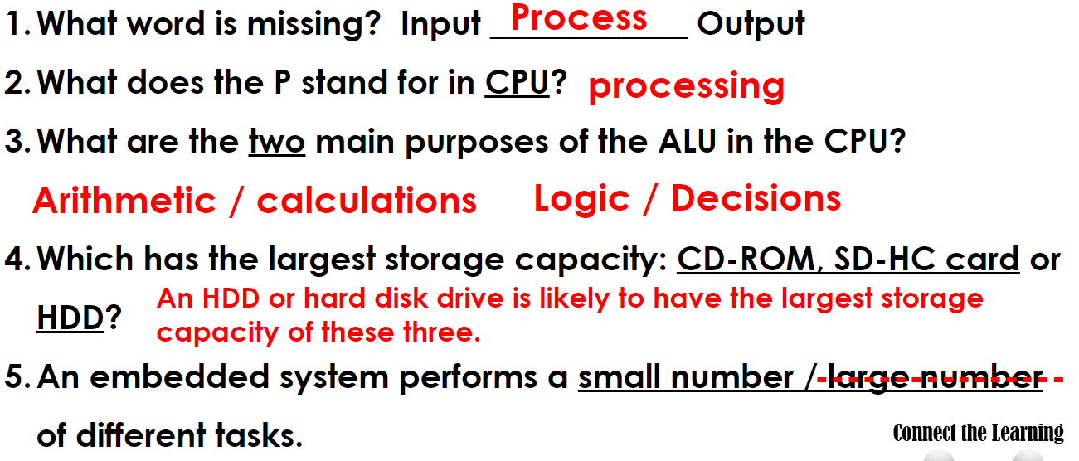
Solutions

Slide 5
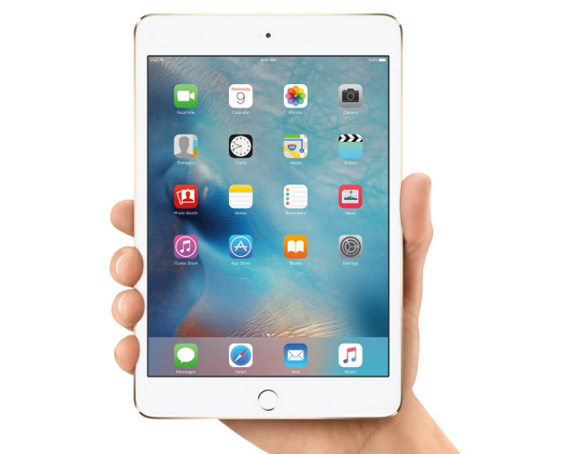
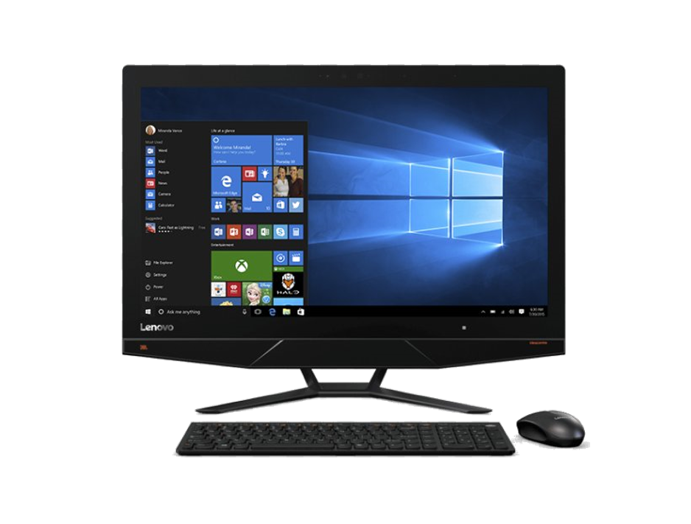

Apart from the type of hardware, what other differences are there in these devices?

Slide 6



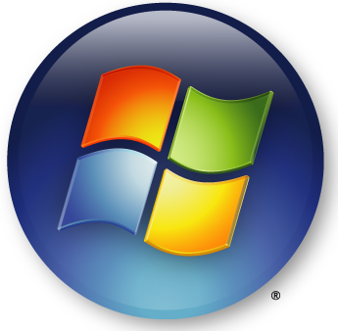

Name the operating systems you have experienced…
iOS/MacOS
Android
Ubuntu
Linux
Windows
Have you heard of any other operating systems?

Slide 7
What makes these operating systems different than the ones you have experienced?
What devices would you expect to see these software on?
Linux is a family of open-source operating systems and forms the kernel for other operating systems such as Android as well as controlling web servers. It is also used as an OS for embedded devices.
Ubuntu is also mostly free and open-source software and is developed for individual computers, network servers in data centres and smart devices as well as robotics.

Slide 8



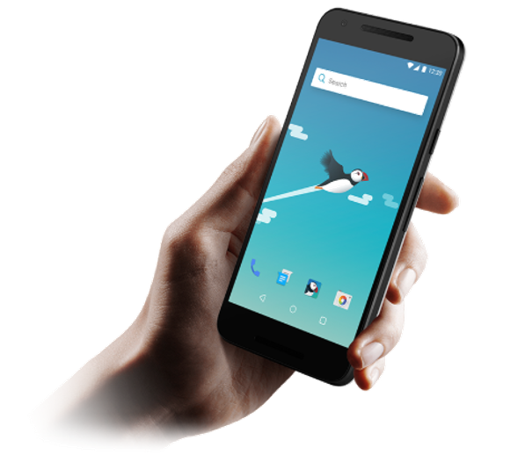
Why do we need an operating system?
An operating system is a platform for apps and programs to inhabit so that the user can see that they are there and access them quickly.

Slide 9
Activity
Here are some examples of the OS’s main functions:
Memory Management
File Management
Process Management
User Interface Management
(these are just a guide, what else can you find)
Research what the main functions of the OS are.
Here are some questions to answer for each function:
What is the primary role of this function?
How does it interact with other functions?
Can you provide examples of how this function operates in popular operating systems?
What are some common challenges or limitations associated with this function?
Presentation Slides / Notes in your notebook / Digital Notes

Slide 10
What are the main functions of an OS?
It is a user interface
The OS allows the user to communicate with the computer, giving instructions, and seeing what the computer has done with the instruction.
It controls hardware
The OS controls how instructions and data are passed to and from hardware attached… like a mouse click, a keyboard press or sound from speakers.
It controls the CPU
The OS controls how data and instructions are sent to the CPU.
It schedules how the CPU will be used to make the computer run as efficiently as possible.

Slide 11

Manages file storage
The OS decides how files will be saved on the hard disk and where they are saved.
The OS also aims to optimize the use of the hard disk, to maximise available space.
The OS controls how files and folders will be named and addressed and linked.
Detects errors
The OS reports any errors in software or hardware to the user.
Sometimes suggests a possible solution to the error.

Slide 12
On a network, it manages users.
Different users of a network will be issued a unique username.
Users can then create a password, which is saved by the operating system, and compared with when the user tries to log in.
The Operating System makes sure that no two users have the same username.

Slide 13
Exam Practice – 8 Marks
Scenario:
Leila works as an IT technician for a small graphic design company. The company uses both Windows and Linux operating systems on different computers.
Leila has been asked to decide which operating system would be more suitable for a new team of designers who need to run advanced design software, store large files securely, and work efficiently with shared resources such as printers and servers.
Task:
Discuss the advantages and disadvantages of Windows and Linux operating systems for this scenario.
In your answer, explain how the features, interface (GUI/CLI), and performance of each system might affect the designers’ work.

Slide 14
Activity - Homework
What is the difference between an operating system and an application program? (1 mark)
List 4 things than an operating system controls or manages? (4 marks)
One function of an operating system is to provide a user interface. Explain what a user interface is? (2 marks)
Explain how an operating system organises files on a hard drive. (3 marks)
Explain how an operating system uses scheduling to share use of the CPU between processes and application programs. (2 marks)

Slide 15



